Slide 1
Privacy Protected Machine Learning
Bhargav Vaduri, Tianyi Niu, Aarav Mehta, Mohan

Slide 2
Importance of Machine Learning Privacy
Datasets used to train models are actual people!
Giving organizations and companies patient data means that companies and patients have to worry about losing patient data in data leaks, being accessed as public information in trial, being used in corporate buyouts etc.
Lack of Privacy discourages people from donating personal data, leading to weak models with high test-time error
Privacy can be introduced to Machine Learning by aggregating completed models

Slide 3
Hypothetical Scenario
Hospital A, B, and C are all contributing to a machine learning algorithm to classify heart disease data.
Each of Hospital A, B, and C train their own individual model using their own data.
They send their completed models, detached from the original test data, to the company, which can aggregate the data and create a novel model
Company has a machine learning model, while data is kept with each original hospital.

Slide 4
Company Resource View
Aggregated Model
A
B
C
D
E
POP A
POP B
POP C
POP D
POP E

Slide 5
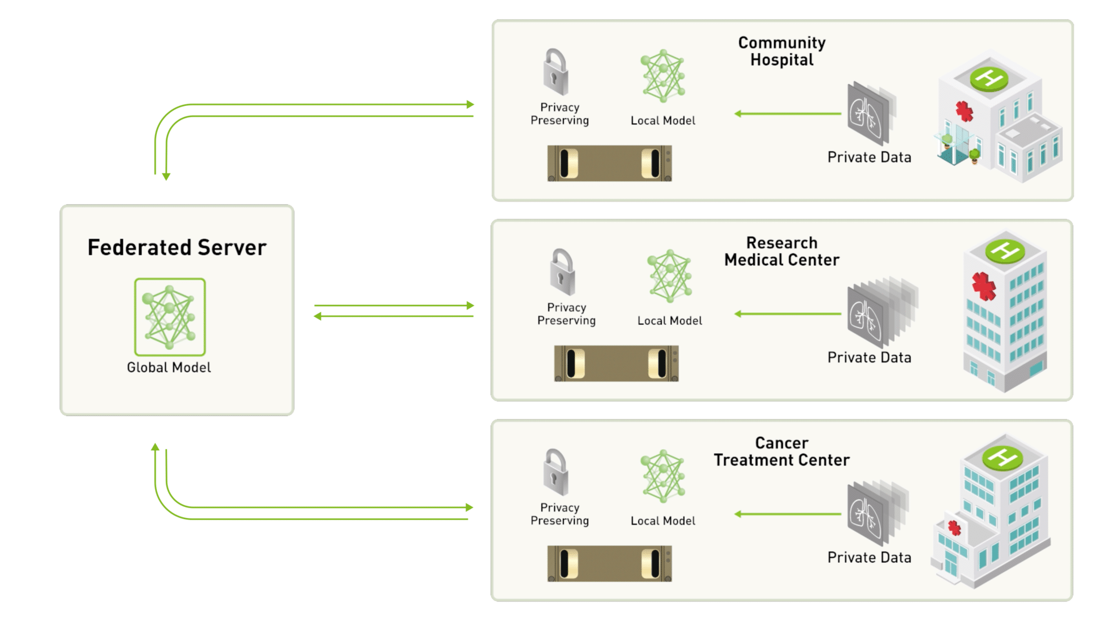
Hospital Resource View
Source: https://blogs.nvidia.com/blog/2019/10/13/what-is-federated-learning/

Slide 6
Methodology
Take dataset and split into different chunks to train individual model, and combine with aggregation method.
3 Training Conditions:
“Real” data set
Unbalanced or Skewed Data set
Individual models have different data distributions
4 Aggregation Methods
Equal Weighted Average
Clipped Average
AUC (Area under the Curve) Weighted
Differential Privacy

Slide 7
Training Condition Graphical

Slide 9
Experiment 3: Training Individual Models on Different Distributions

Slide 10
Issues and Challenges
Small Dataset Size
With aggregated dataset, chunking these into individual data sets into smaller data sets incurs an extremely large penalty on the scores of the individually trained models resulting in a weaker aggregated model than a traditionally trained balanced model.
Multiple Distributions
When the individual models are trained on different underlying distributions, to

Slide 11
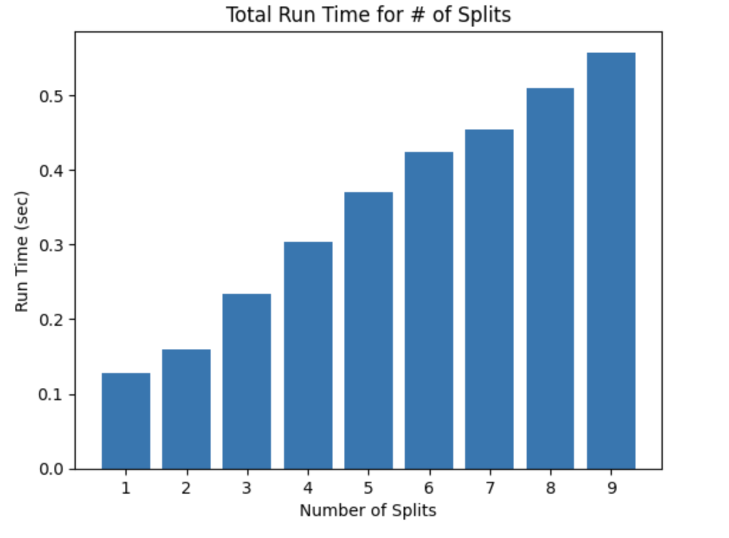
Future Directions
Regression vs. Classification
Neural Networks (Other models for each hospital)
Do certain models aggregate better under different algorithms?
Explore more complex aggregation algorithms
Optimizing runtime vs privacy balance
Incorporating FHE into pipeline endpoints

Slide 12
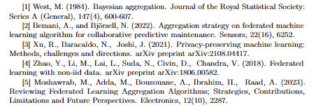
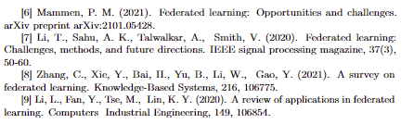
References

